Slide 1
Big Mountain Resort
Mehmet Ozer

Slide 2
What is the problem?
How can Big Mountain Resort keep profit margin at at least 9.2% after investing in an additional chair which brings in $1,540,000 in operating costs each year by investigating possible ways to increase revenue.
The new chair will bring $1,540,000 in operating costs. Big Mountain Resort needs to keep the profit margin at 9.2% as it was before installing the chair to be able to make enough profit to continue the business.
Keeping the profit margin at 9.2% or better.

Slide 3
What We Can Do About It
Finding ways to support the revenue and profits.
Exploring options which other ski resorts might already been conducting.
Finding a working solution may take time and the business could lose profit in the meantime.
Change of business structure may not be feasible at the beginning.
Some stakeholders may not agree with the found solutions

Slide 4
Recommendation
After detailed analysis of the data provided I can conclude that Big Mountain Resort as one of the ski resorts in the Northern United States can follow the guides described below to be able to keep the profit margin as it currently is.
To keep the margin at this level there are different approaches which could be used. The validity of our model lies in the assumption that other resorts accurately set their prices according to what the market (the ticket-buying public) supports. The fact that our resort seems to be charging that much less that what's predicted suggests our resort might be undercharging. But if ours is mispricing itself, are others? It's reasonable to expect that some resorts will be "overpriced" and some "underpriced."

Slide 5
Recommendation
The expected number of visitors over the season is 350,000 and, on average, visitors ski for five days. Assume the provided data includes the additional lift that Big Mountain recently installed. If Big Mountain adds a run, increases the vertical drop by 150 feet, and installs an additional chair lift then the support for ticket price will increase by $1.99 and over the season, this could be expected to amount to $3.474.638. So that the profit margin can be maintained or even increased.

Slide 6
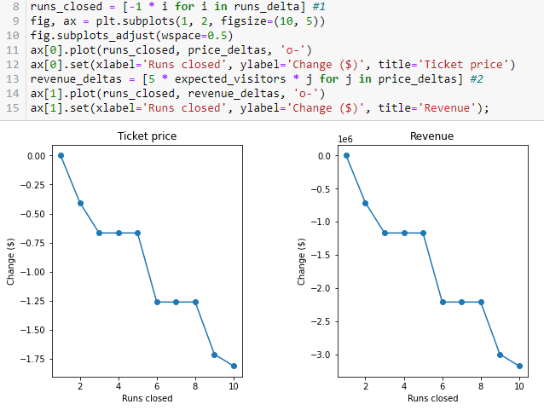
Why
The model says closing one run makes no difference. Closing 2 and 3 successively reduces support for ticket price and so revenue. If Big Mountain closes down 3 runs, it seems they may as well close down 4 or 5 as there's no further loss in ticket price. Increasing the closures down to 6 or more leads to a large drop.

Slide 7
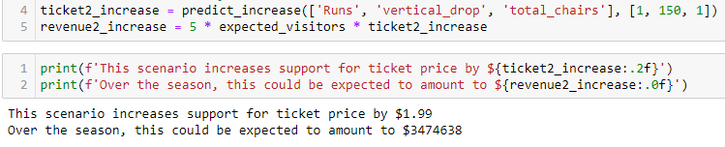
Conclusion
Although the longest run feature was used in the linear model, the random forest model (the one we chose because of its better performance) only has longest run way down in the feature importance list. The support for ticket price will increase by $1.99 and over the season, this could be expected to amount to $3.474.638. So that the profit margin can be maintained or even increased.

